Slide 1
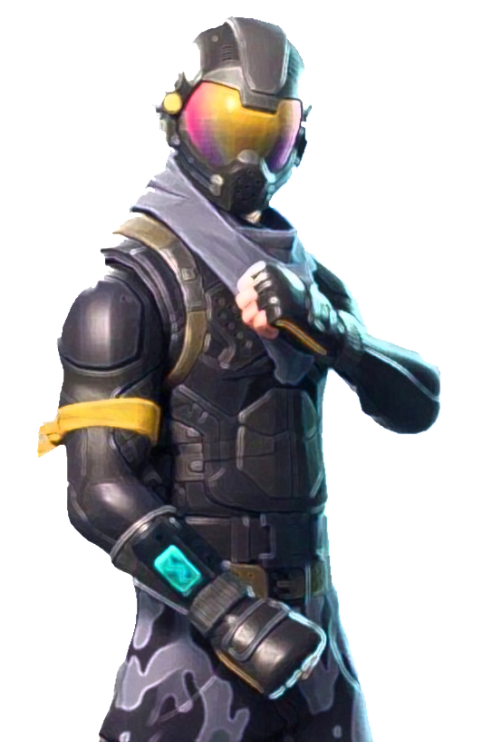

python final project
Fortnite
Tracker
Brian Caulfield - Johnny Ishii - Sheng Lo - Alice Kim

Slide 2
Team Members
÷
+
Brian Caulfield
Johnny Ishii
Sheng Lo
Alice Kim

Slide 3
+
Purpose
FORTNITE TRACKER
what weapon the players are using?
The program creates a real time tracker in Fortnite Battle Royal.
The program will collect the data from the kill feed and provide real time stats for the user.
+
Fortnite
Tracker
current kills
wins
kill/death
who killed who

Slide 4
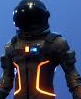
+
2 APIs
FORTNITE TRACKER
The Google Cloud client library
This API is used as we need to get real time data from the screenshot images. We can import the Google Cloud client library
Fortnite API
We are getting the user information from the Fortnite API to get the lifetime data. Such as overall kill count, total game wins.
Fortnite
Tracker
+

Slide 5
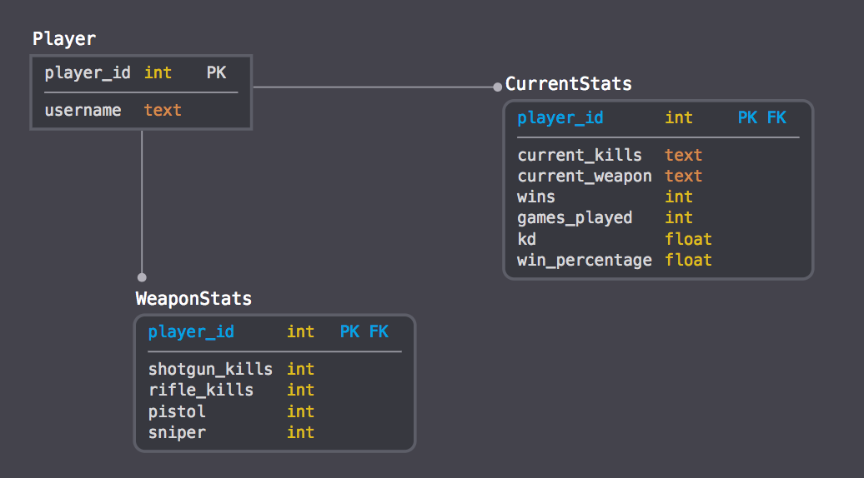
+
Our data base
FORTNITE TRACKER
Player
Current Stats
WeaponStats
from fortnite API

Slide 6
FORTNITE TRACKER
+
Main.py
process text (input)

Slide 7
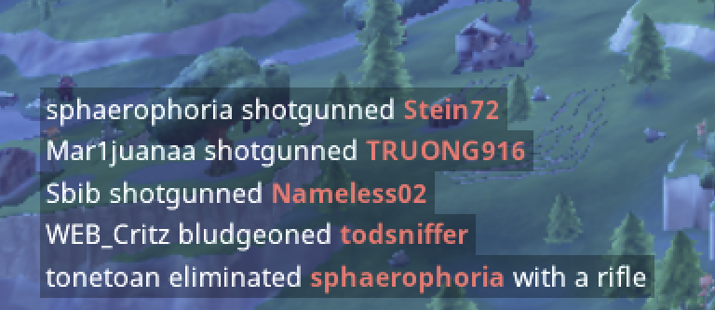
+
Main.py
FORTNITE TRACKER
Our program’s input is from the from kill feed.
The kill feed is generated by taking the screenshot, recognizing the string from it.
From this string, we obtain information to update our database.
- the killer
- way the player died
- who is dead
- the possible weapon

Slide 8
+
Main.py
FORTNITE TRACKER
We process the text by using several functions.
1)
def take_windows_screenshot(x, y):
“""
Takes a screenshot of the bottom left hand corner where the kill feed is located
"""
2)
def process_text(line, fortnite_database, checked = False):
"""
Process the text that is received from the google vision api
"""

Slide 9
FORTNITE TRACKER
+
audit_way.py
checks for string input error

Slide 10
+
audit_way.py
FORTNITE TRACKER
Sometimes the reading in the string may cause an error (eg, a letter might be off).
This function checks for the similarity of words and fixes the string if it is within the threshold.
1)
def check(self, line):
"""
Checks to see if any of the words in the line are possible the self.ways to die
"""
2)
def recreate_sentence(self, line, way, index):
"""
Recreates the sentence from line and way with the index of where the way should be
"""

Slide 11
FORTNITE TRACKER
+
FrotniteTracker.py
creates DataBase

Slide 12
+
fortnitetracker.py
FORTNITE TRACKER
This creates the database.
def add_player(self, name):
def update_weapon_stats(self, username, current_wep):
def update_db(self, line, way, current_wep=None):
def add_weapon_stats(self, name):
def get_api_stats(self, username, platform, priority_level, original_username=None):

Slide 13
FORTNITE TRACKER
+
Unittesting.py
This class goes over each functions and tests

Slide 14
+
unittesting.py
FORTNITE TRACKER
def test_add_player(self):
def test_add_weapon_stats(self):
def test_update_weapon_stats(self):
def test_update_db(self):
def test_process_text(self):
def test_update_sentence(self):

Slide 15
FORTNITE TRACKER
+
Interesting problem that we ran into
Google’s computer vision api
Multithreading

Slide 16
+
Interesting problem
FORTNITE TRACKER
1)
Sometimes we got incorrect/inadmissible information from Google’s computer vision api so we have to use NLP to help correct some of the phrases.
2)
Running the web application and the program at the same time would be impossible, since the code can’t proceed until the dash website is closed. We solved this by using multithreading to allow both of them to run simultaneously.

Slide 17
FORTNITE TRACKER
+
Demo!

